Slide 1

Building a GPT for Public Procurement Analysis
From Predefined Instructions to Automated Insights
MASTER THESIS NO. 2024: ____
KR 201450124
Supervised by: Dr. Gurdal Ertek

Slide 2
01
Introduction

Slide 3
What is a Public Procurement GPT?
Definition
A GPT that analyzes public procurement datasets, focusing on spending efficiency, procurement assessment, and corruption risk.
Dataset
Uses the Global Public Procurement Dataset (GPPD) with over 72 million contracts from 42 countries.
Purpose
Automating predefined analyses based on user instructions, with a focus on generating findings, insights, and recommendations.

Slide 4
02
The Problem It Solves

Slide 5
Why Automate Analysis?
Manual analysis of massive datasets is time-consuming and error-prone.
Public procurement data is critical for identifying inefficiencies, risks, and corruption.
Automating analysis ensures consistency, speed, and detailed reporting with actionable insights.

Slide 6
03
Building the GPT

Slide 7
How I Built the Public Procurement GPT
Set Clear Instructions
Program Responses
Define the Tasks
Upload Dataset
Automate Insights

Slide 8
05
Prompt Selection Process

Slide 9
Generated 100 Initial Prompts
Selected Top 20 Prompts
Collaborated with ChatGPT to brainstorm and create a set of 100 prompts for analysis.
Filtered down to the 20 highest-scoring prompts, focusing on those that best matched our objectives.
1
2
3
4
Applied Scoring System
Final Dashboard Creation
Each prompt was scored based on criteria for professionalism and relevance, ensuring alignment with our analysis goals.
Used the top 20 prompts to develop the final dashboard, showcasing key insights and analysis.

Slide 10
Dashboard Creation
06

Slide 11
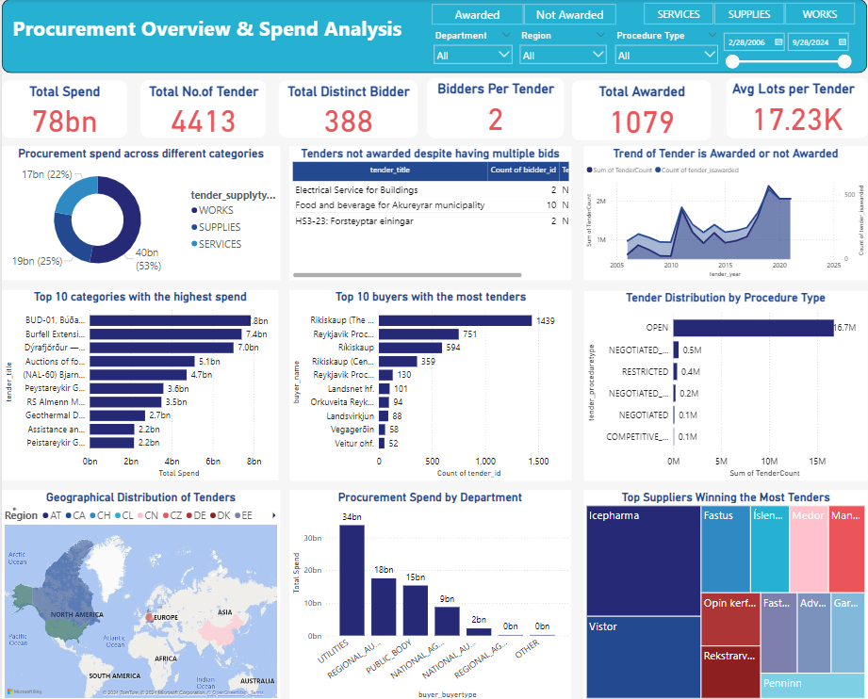
Dashboard 1

Slide 12
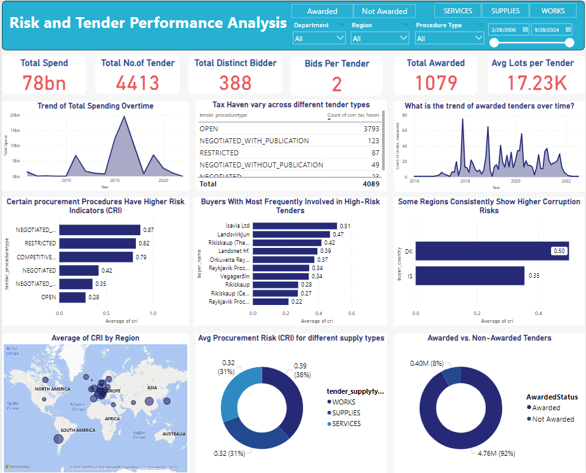
Dashboard 2

Slide 13
07
Predefined Analyses Overview

Slide 14
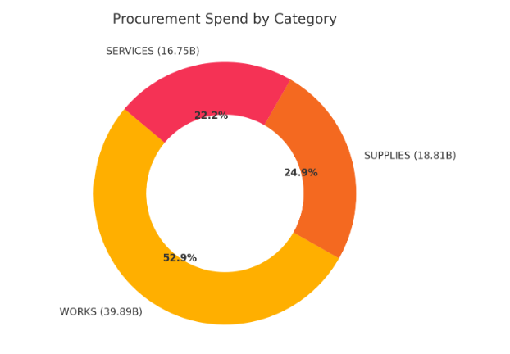
Example Prompts and Generated Graphs
Example Analysis 1 – Procurement Spend by Category
Prompts:
“1. Use 'tender_supplytype' as the category and 'tender_finalprice' for spend.
2. Generate a Donut chart with K/M/B-formatted labels, showing values and percentages.
3. Ensure readable text, and remove blanks.
4. Provide findings, insights, and recommendations.”
Output:
chatGPT clean and format data and add appropriate data label. Eventually it will generate findings, insights, and recommendations.

Slide 15
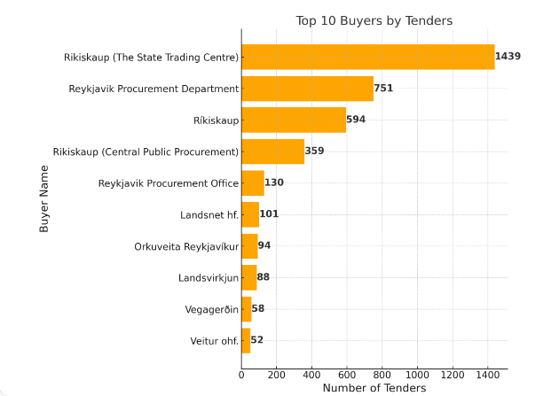
Example Prompts and Generated Graphs
Example Analysis 2 - Top 10 Buyers by Tenders.
Prompts:
1. Use 'buyer_name' on Y-axis and count of 'tender_id' on X-axis.
2. Generate a Bar chart with the top 10 buyers by tender count.
3. Shorten Y-axis names, fix errors/duplicates.
4. Provide findings, insights, and recommendations.
Output:
chatGPT clean and format data and add appropriate data label. Eventually it will generate findings, insights, and recommendations.

Slide 16
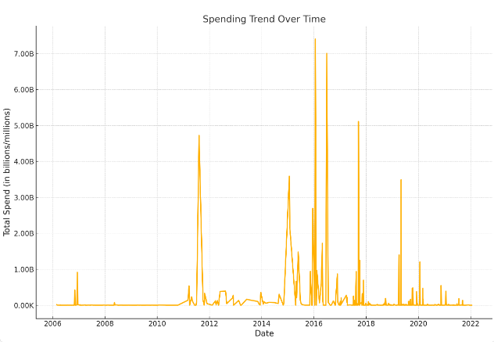
Example Prompts and Generated Graphs
Example Analysis 3 - Top 10 Buyers by Tenders.
Prompts:
1. Use 'tender_biddeadline' as X-axis, 'tender_finalprice' as Y-axis.
2. Generate a Line chart showing total spend over time.
3. Make the line chart smooth and avaid the small point on the line. Show data label in proper format.
4. Provide findings, insights, and recommendations.
Output:
chatGPT clean and format data and add appropriate data label. Eventually it will generate findings, insights, and recommendations.

Slide 17
Handling Data Issues Automatically
The GPT removes blanks, resolves duplicate bars, and formats labels to be K/M/B.
Automates label visibility and chart readability.
Makes sure the results are user-friendly and easy to interpret.

Slide 18
08
Generating Detailed Reports

Slide 19
Writing a Detailed Report
GPT generates a full report on request with findings, insights, and recommendations.
Report includes visualizations embedded directly into the document.
GPT supports reports of up to 4000 words with key statistics and professional formatting.

Slide 20
09
Conclusion

Slide 21
Conclusion
Key Takeaways
The GPT automates public procurement analysis, providing clear insights based on predefined instructions.
Next Steps
Define tasks, prepare your dataset, and set clear instructions for the GPT.
Call to Action
Start automating your data analysis to save time and improve accuracy.

Slide 22
THANK YOU!
DO YOU HAVE ANY QUESTIONS?

